Slide 1
COCOMO COCOMO II AGILE WEBAPP
THE MANAGEMENT SPECTRUM

Slide 2
Function oriented METRICS
Function-oriented software metrics use a measure of the functionality delivered by the application as a normalization value.
The most widely used function oriented metric is the function point (FP). Computation of the function point is based on characteristics of the software’s information domain and complexity.
Using historical data, the FP metric can then be used to
estimate the cost or effort required to design, code, and test the software
predict the number of errors that will be encountered during testing
forecast the number of components and/or the number of projected source lines in the implemented system.

Slide 3
FUNCTION POINT METRICS
Function points are derived using an empirical relationship based on countable (direct) measures of software’s information domain and qualitative assessments of software complexity
Information domain values are defined in the following manner:
Number of external inputs (EIs).
Number of external outputs (EOs)
Number of external inquiries (EQs)
Number of internal logical fi les (ILFs)
Number of external interface fi les (EIFs).

Slide 4
FUNCTION POINT METRICS

Slide 5
FUNCTION POINT METRICS
To compute function points (FP), the following relationship is used:
where count total is the sum of all FP entries obtained from Figure
The F i ( i = 1 to 14) are value adjustment factors (VAF) based on responses to the following questions
1. Does the system require reliable backup and recovery?
2. Are specialized data communications required to transfer information to or from the application?
3. Are there distributed processing functions?
4. Is performance critical?

Slide 6
Function oriented METRICS
5. Will the system run in an existing, heavily utilized operational environment?
6. Does the system require online data entry?
7. Does the online data entry require the input transaction to be built over multiple screens or operations?
8. Are the ILFs updated online?
9.Are the inputs, outputs, files, or inquiries complex?
10. Is the internal processing complex?
11. Is the code designed to be reusable?
12. Are conversion and installation included in the design?

Slide 7
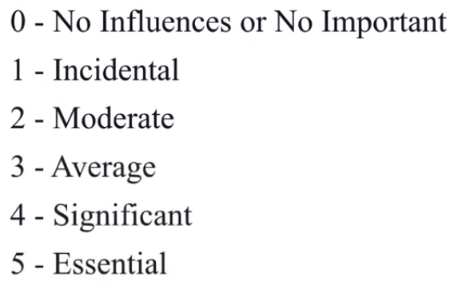
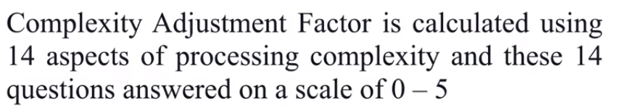
Function oriented METRICS
13. Is the system designed for multiple installations in different organizations?
14. Is the application designed to facilitate change and ease of use by the user?
Each of these questions is answered using an ordinal scale that ranges from 0 (not important) to 5 (absolutely essential). The constant values in Equation and the weighting factors that are applied to information domain counts are determined empirically.

Slide 8
Function oriented METRICS

Slide 9
Function oriented METRICS

Slide 10
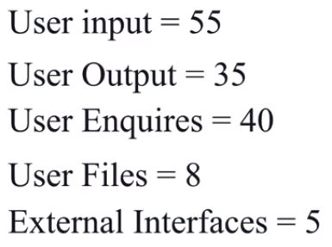
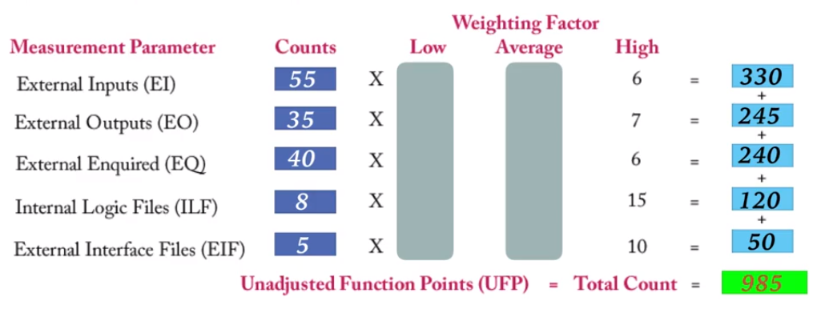
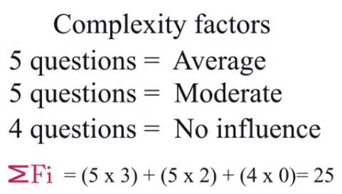
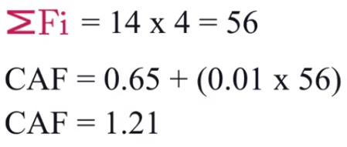
Function oriented METRICS

Slide 11
Loc and fp metrics
The function point, like the LOC measure, is controversial.
FP is programming language–independent, making it ideal for applications using conventional and nonprocedural languages
It is based on data that are more likely to be known early in the evolution of a project, making FP more attractive as an estimation approach.
The relationship between lines of code and function points depends upon the programming language that is used to implement the software and the quality of the design

Slide 12
Function oriented METRICS

Slide 13
Object oriented METRICS
Conventional software project metrics (LOC or FP) can be used to estimate object-oriented software project
These metrics do not provide enough granularity for the schedule and effort adjustments that are required as you iterate through an evolutionary or incremental process.
The following set of metrics are used for Object oriented
Number of scenario scripts.
Number of key classes
Number of support classes.
Average number of support classes per key class.
Number of subsystems

Slide 14
Empirical estimation model
An estimation model for computer software uses empirically derived formulas to predict effort as a function of LOC or FP.
The empirical data that support most estimation models are derived from a
limited sample of projects
No estimation model is appropriate for all classes of software and in all development environments.
An estimation model should be calibrated to reflect local conditions.
The model should be tested by applying data collected from completed projects, plugging the data into the model, and then comparing actual to predicted results.

Slide 15
COCOMO MODEL
CO –CONSTRUCTIVE
CO –COST
MO – MODEL
The COCOMO is the most widely used software estimation Model
The COCOMO model predicts the effort and duration of a project based on inputs relating to the size of the resulting systems and a number of“ cost drives " that affect productivity.

Slide 16
Cocomo model

Slide 17
Cocomo model

Slide 18
Cocomo model

Slide 19
Cocomo model

Slide 20
Cocomo model

Slide 21
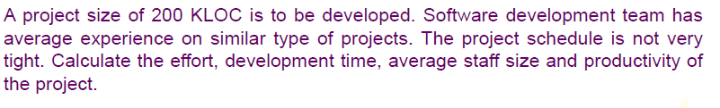
Cocomo model

Slide 22
Cocomo model

Slide 23
Cocomo model

Slide 24
Cocomo model

Slide 25
Cocomo ii model

Slide 26
Cocomo ii model

Slide 27
Cocomo model

Slide 28
Estimation for agile development

Slide 29
estimation for webapp projects

Slide 30
Project Scheduling

Slide 31
scheduling

Slide 32
Time line charts

Slide 34
Tracking the schedule

Slide 35
Function oriented METRICS
Funct

Slide 36
Function oriented METRICS
Funct

Slide 37
Function oriented METRICS
Funct

Slide 38
Function oriented METRICS
Funct

Slide 39
Function oriented METRICS
Funct

Slide 40
Function oriented METRICS
Funct

Slide 41
Function oriented METRICS
Funct

Slide 42
Function oriented METRICS
Funct

Slide 43
Function oriented METRICS
Funct

Slide 44
Function oriented METRICS
Funct

Slide 45
Function oriented METRICS
Funct

Slide 46
Function oriented METRICS
Funct

Slide 47
Function oriented METRICS
Funct

Slide 48
Function oriented METRICS
Funct

Slide 49
Function oriented METRICS
Funct

Slide 50
Function oriented METRICS
Funct

Slide 51
Function oriented METRICS
Funct

Slide 52
Function oriented METRICS
Funct

Slide 53
Function oriented METRICS
Funct

Slide 54
Function oriented METRICS
Funct

Slide 55
Function oriented METRICS
Funct

Slide 56
Function oriented METRICS
Funct

Slide 57
Function oriented METRICS
Funct

Slide 58
Function oriented METRICS
Funct

Slide 59
Function oriented METRICS
Funct

Slide 60
Function oriented METRICS
Funct

Slide 61
Function oriented METRICS
Funct

Slide 62
Function oriented METRICS
Funct

